Slide 1




Naan Mudhalvan
Smart Internz
Smart Bridge
NAAN MUDHALVAN
MERN Stack powered by Mongo DB
1

Slide 2


ShopEZ: E-commerce Application
Created by Team Members of Final Year IT (A)
Josan George
Madesh D
Mohammad Zohair
Keerthika I
2

Slide 3


Content
Abstract
Apllication Flow
Introducation
Project setup & Configuration
System Requirements
Pre-requisties
Project Implementation & Execution
Architecture & ER Diagram
Project Structure
Conclusion
3

Slide 4

Abstract
ShopEZ is a MERN-based e-commerce platform offering a seamless shopping experience with features like product discovery, secure authentication, efficient cart management, and reliable payments. It includes personalized recommendations, streamlined checkout, and instant order updates for customers, while sellers benefit from dashboards for order management and analytics. This documentation covers its requirements, architecture, features, and development steps.
Keywords: E-commerce, MERN Stack, Online Shopping, Secure Checkout, Seller Dashboard
4

Slide 5
1.Intoduction
ShopEZ is a MERN-based e-commerce platform designed for convenient, personalized online shopping. It features secure checkout, real-time updates, and recommendations for customers, along with a seller dashboard for order management and analytics. This documentation covers its architecture, features, and workflows, showcasing its scalable and user-friendly design.
5

Slide 6
1.1. PURPOSE
The purpose of the ShopEZ e-commerce platform is:
⦁ To provide a centralized online platform for convenient, personalized shopping experiences.
⦁ To enable users to browse a wide range of products, view detailed descriptions, and make purchases securely.
⦁ To offer sellers a robust dashboard for managing product listings, tracking orders, and accessing customer analytics to support business growth.
⦁ To ensure a seamless, secure checkout process, protecting users’ personal and payment information.
⦁ To create a scalable, efficient solution for both customers and sellers, designed to enhance the e-commerce experience
6

Slide 7
1.2. SCOPE
The scope of the ShopEZ platform includes the development, deployment, and maintenance of a comprehensive e-commerce system using the MERN stack. Key components and features within this scope include:
User Management: Registration, login, profiles, and secure sessions.
Product Management: Tools for sellers to manage product listings.
Recommendations: Personalized product suggestions for customers.
Shopping Cart & Checkout: Cart functionality with secure payments.
Order Tracking: Real-time order status updates and confirmations.
Payments: Integration with secure payment gateways.
Cross-Device Access: Seamless use on desktops, tablets, and smartphones.
Dashboards: Admin tools for managing users, products, and analytics, plus a seller dashboard for order and sales tracking.
7

Slide 8
1.3. PROJECT OBJECTIVE
The objective of the ShopEZ project is to develop a versatile and user-friendly e-commerce platform using the MERN stack. This platform aims to deliver an enjoyable shopping experience for users and a powerful management system for sellers by incorporating essential e-commerce functionalities, including secure checkout, order tracking, product recommendations, and sales analytics.
8

Slide 9
2. SYTEM REQUIREMENTS
2.1. HARDWARE
⦁ Operating System: Windows 8 or higher
⦁ RAM: 4 GB minimum (8 GB recommended for optimal performance)
2.2. NETWORK
⦁ Bandwidth: 30 Mbps for a smooth online experience and faster testing.
2.3. SOFTWARE
⦁ Node.js: LTS version for both back-end and front-end development
⦁ MongoDB: For database management, using either MongoDB Atlas or a local instance
⦁ React.js: Front-end framework for building the user interface
⦁ Express.js: Back-end framework for handling server operations and APIs
⦁ Git: For version control and collaboration
⦁ Code Editor: e.g., Visual Studio Code for development
⦁ Web Browsers: At least two browsers installed for testing compatibility (e.g., Chrome and Firefox)
9

Slide 10
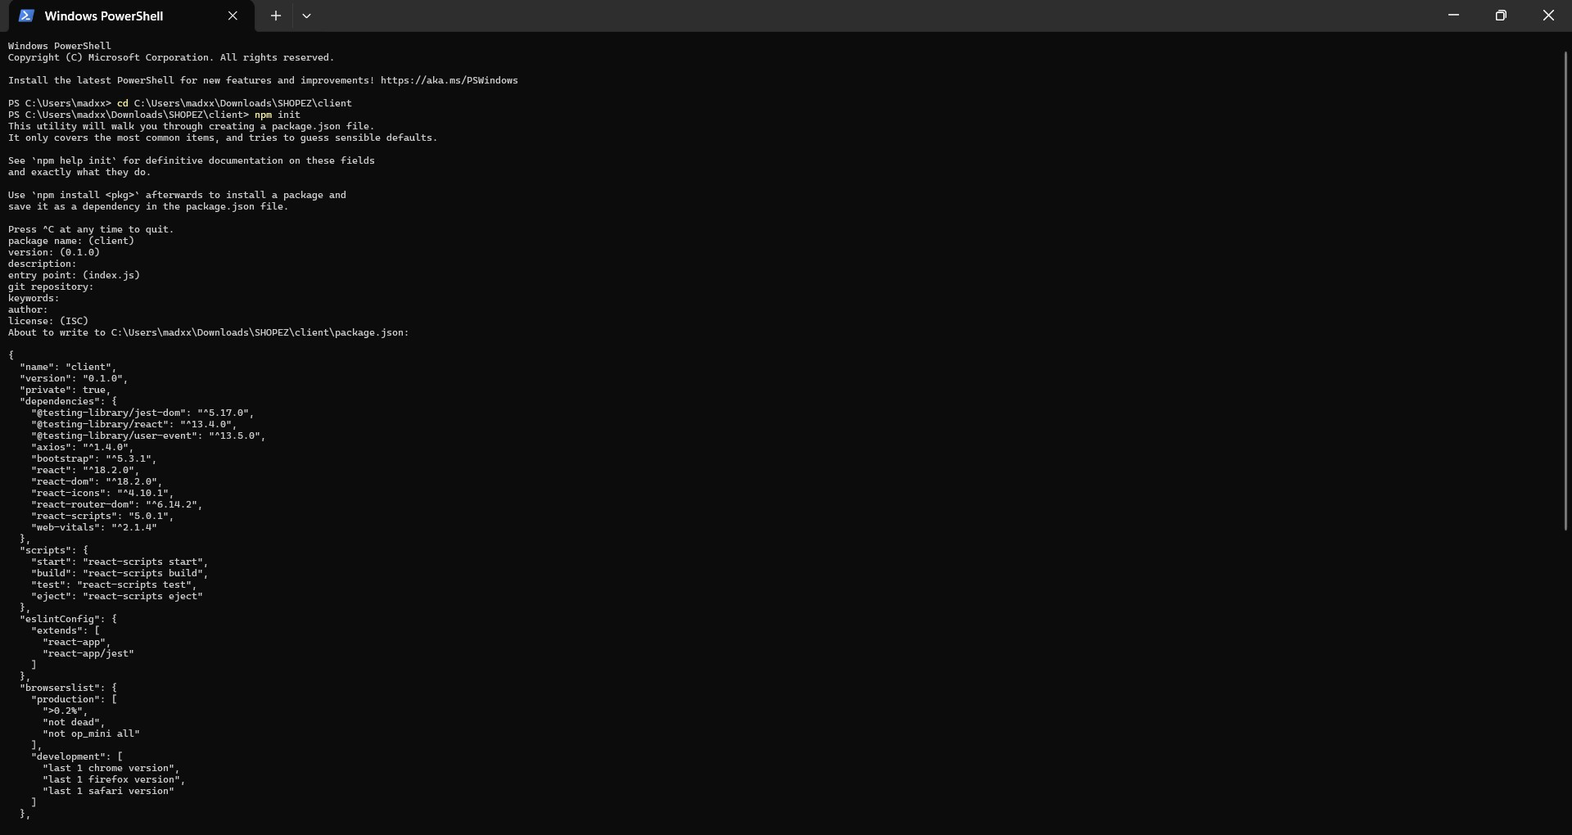
3. PRE-REQUISITES
To develop the ShopEZ e-commerce application using Node.js, Express.js, MongoDB, and React.js, here are the essential prerequisites
Key Prerequisites
⦁ Node.js and npm:
Node.js is a runtime environment that enables JavaScript to run server-side, offering scalability and efficiency for network applications.
⦁ Download: ⦁ Node.js
⦁ Installation Instructions: ⦁ Node.js Installation Guide
⦁ Run npm init to set up the project dependencies.
10

Slide 11
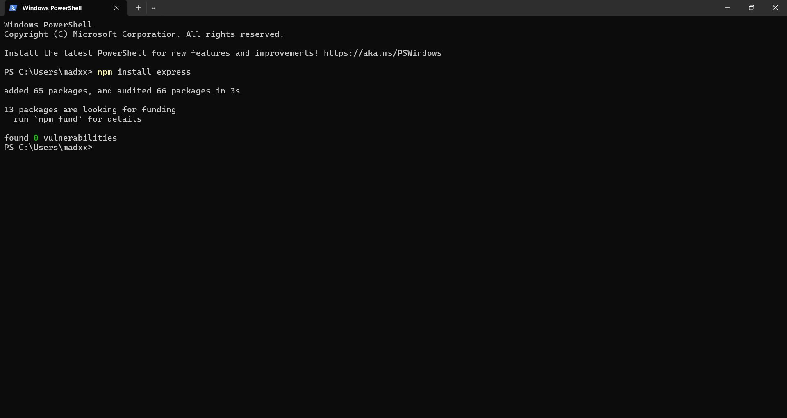
⦁ Express.js:
⦁ Express.js is a lightweight and efficient web framework for Node.js that simplifies the creation of APIs and web applications, supporting routing, middleware, and a modular structure.
⦁ Installation: Open your terminal and run: npm install express
11

Slide 12
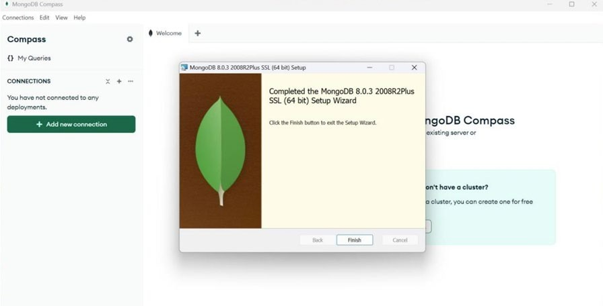
⦁ MongoDB:
⦁ MongoDB is a NoSQL database ideal for handling diverse data types, offering scalability and flexibility with JSON-like storage. It’s highly compatible with Node.js, making it suitable for large-scale applications.
⦁ Download: ⦁ MongoDB Community Server
⦁ Installation Instructions: ⦁ MongoDB Installation Guide
12

Slide 13
⦁ React.js:
⦁ React.js is a widely used JavaScript library for building interactive user interfaces. It enables reusable UI components and dynamic web applications.
⦁ Installation Guide: ⦁ React.js Installation
⦁ HTML, CSS, and JavaScript:
⦁ Basic knowledge of HTML, CSS, and JavaScript is essential for structuring, styling, and enabling interactivity on the client-side.
⦁ Database Connectivity:
⦁ Use a MongoDB driver or an ODM like Mongoose to connect the Node.js server with MongoDB for CRUD operations.
⦁ Additional UI Libraries:
⦁ Utilize Material-UI and Bootstrap for enhanced styling and responsive components.
13

Slide 14
Install dependencies:
Client:
Bash
cd client
npm install
Server:
Bash
cd server
npm install
Start the Development Server
⦁ To launch the development server, execute:
Bash
npm start
⦁ Access the ShopEZ app at http://localhost:3000 by default.
14

Slide 15
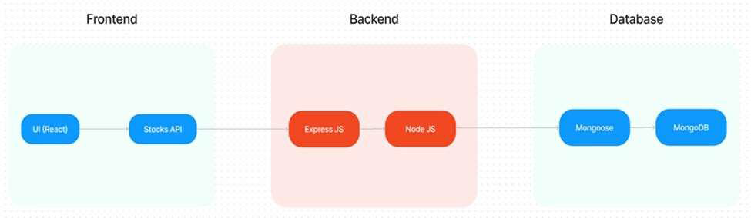
4.ARCHITECTURE
15

Slide 16
4.1. TECHNICAL ARCHITECTURE
The ShopEZ application uses a client-server model for efficient data flow and responsive user interactions.
Client: Built with React, the front-end handles UI and product presentation using Material-UI and Bootstrap for a polished, responsive design. Communication with the back-end is managed via RESTful APIs using Axios.
Server: The back-end, developed in Express.js with MongoDB, handles server-side logic and database operations for user, product, and order data.
Features:
Data Exchange: RESTful APIs enable smooth front-end and back-end communication.
Security: JWT ensures secure, role-based access for customers, sellers, and admins.
Real-Time Updates: Users receive instant notifications like order confirmations, while sellers access sales analytics.
Third-Party Integrations: Includes secure payment gateways and admin tools for data visualization.
This architecture supports scalability, flexibility, and an enhanced user experience.
16

Slide 17
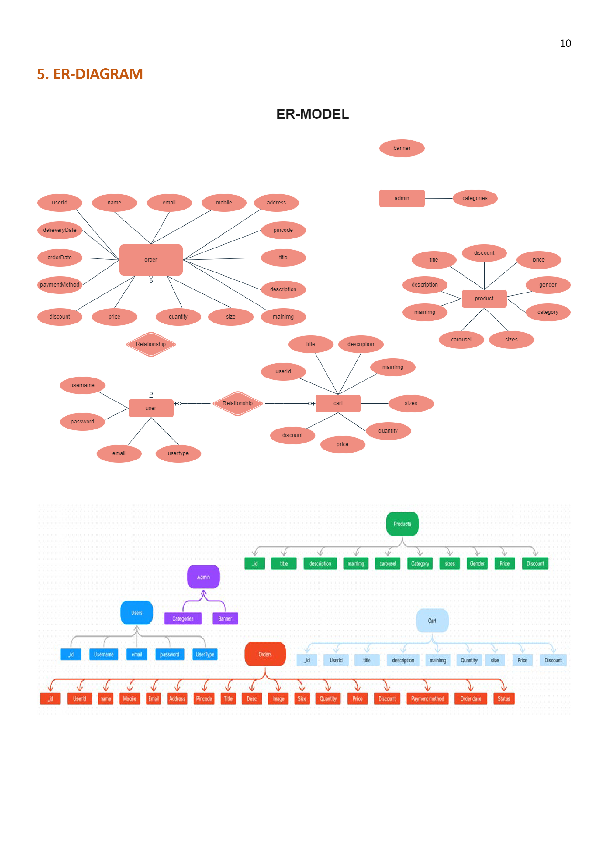
5.ER DIAGRAM
a. USERS Entity
b. PRODUCTS Entity
c. CART Entity
d. ORDERS Entity
e. ADMIN Entity
Summary of Relationships:
⦁ Users and Orders: Each user can place multiple orders, with each order containing details on the products, payment, and shipping information.
⦁ Users and Cart: Users can add products to their cart for potential purchase, with each cart linked to a unique user.
⦁ Admin and Products: Admins manage the catalog of products available on ShopEZ, including adding or modifying listings and categories.
17

Slide 18
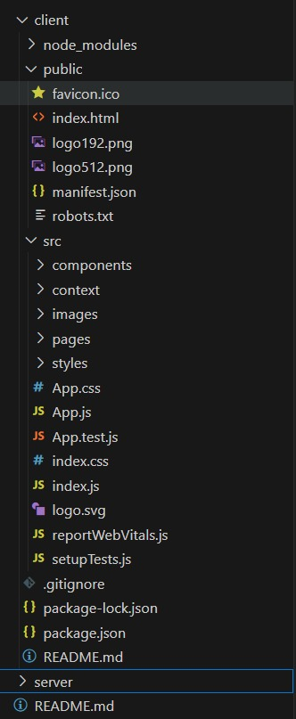
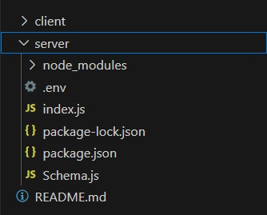
6. PROJECT STRUCTURE
The ShopEZ e-commerce application is structured into frontend and backend directories, following a modular approach for better scalability and maintainability. This structure organizes components by functionality, supports role-based features, and simplifies code management for both developers and administrators.
Frontend Structure
Backend Structure
18

Slide 19
7. APPLICATION FLOW
1. Customer Flow
⦁ Account Registration
⦁ Login
⦁ Product Browsing
⦁ Add to Cart
⦁ Checkout
⦁ Order Confirmation & Tracking
19

Slide 20
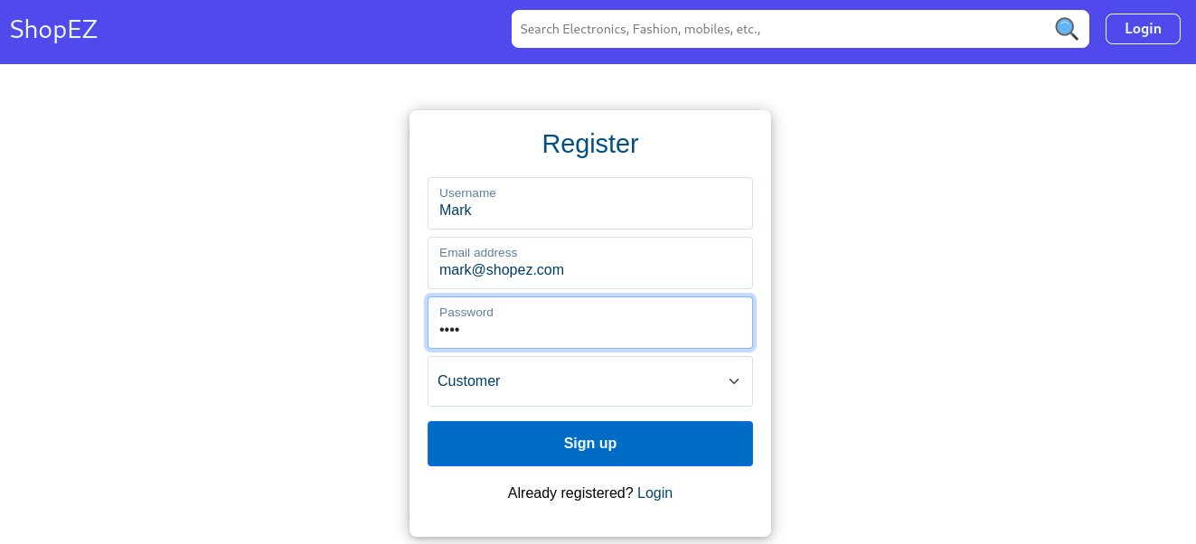
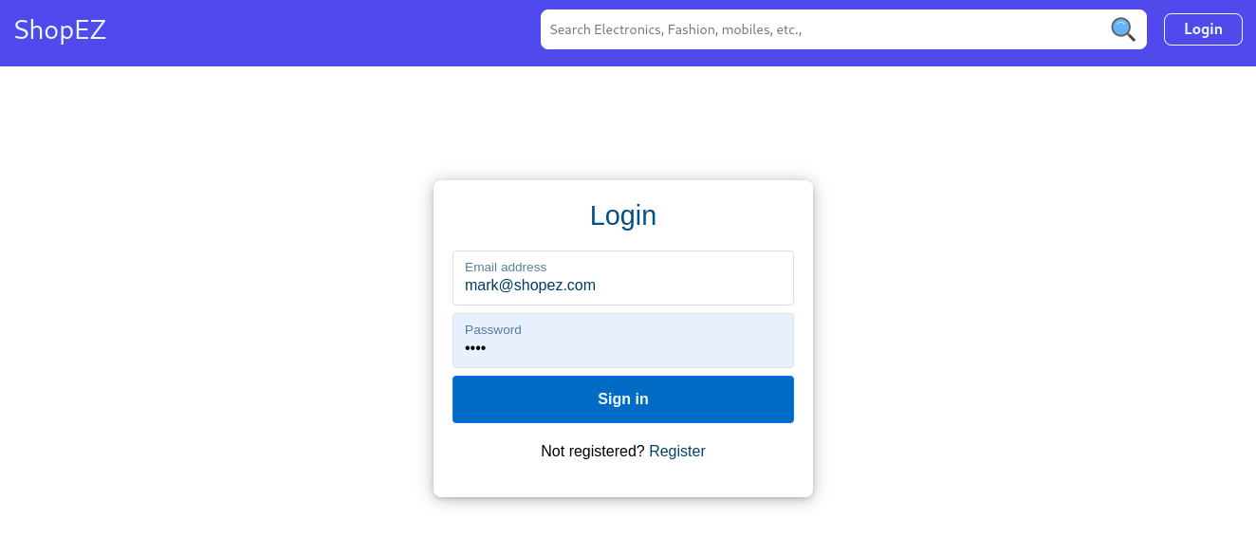
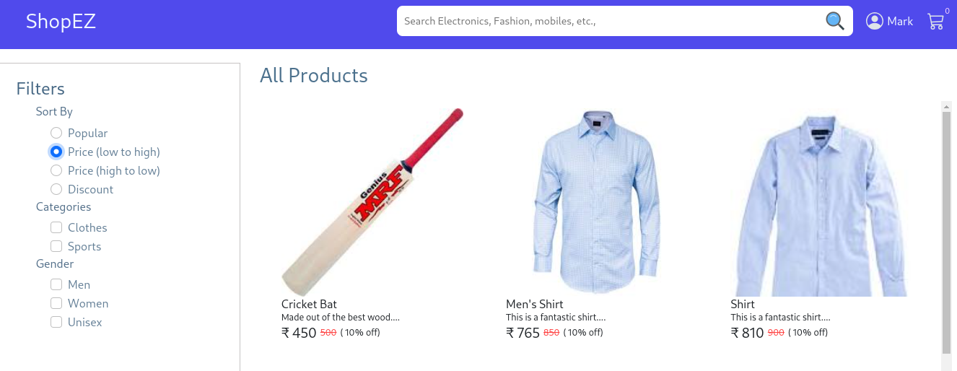
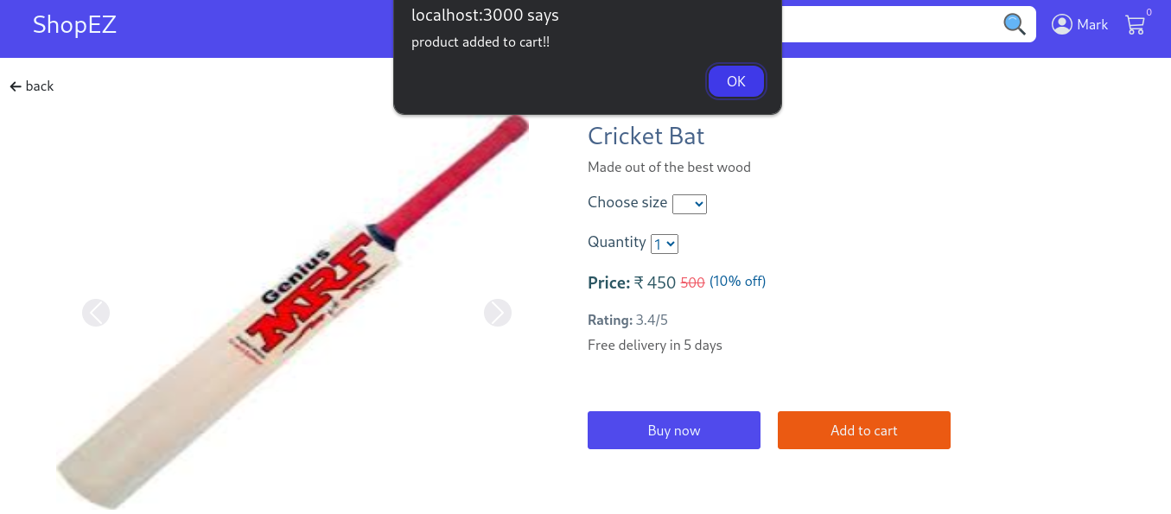
20

Slide 21
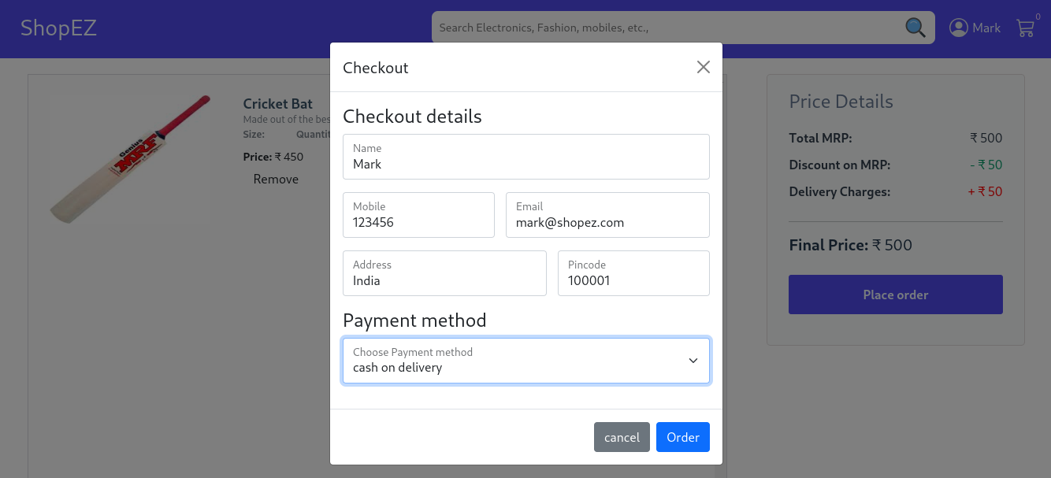
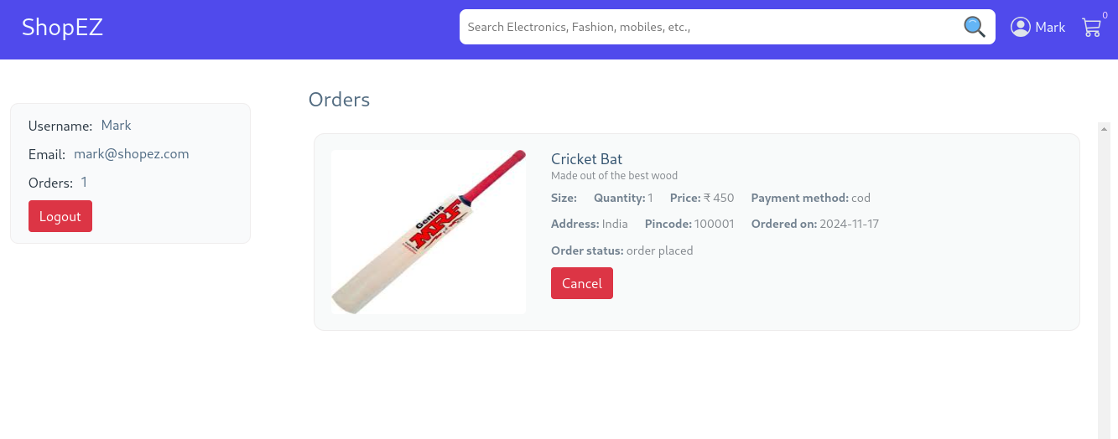
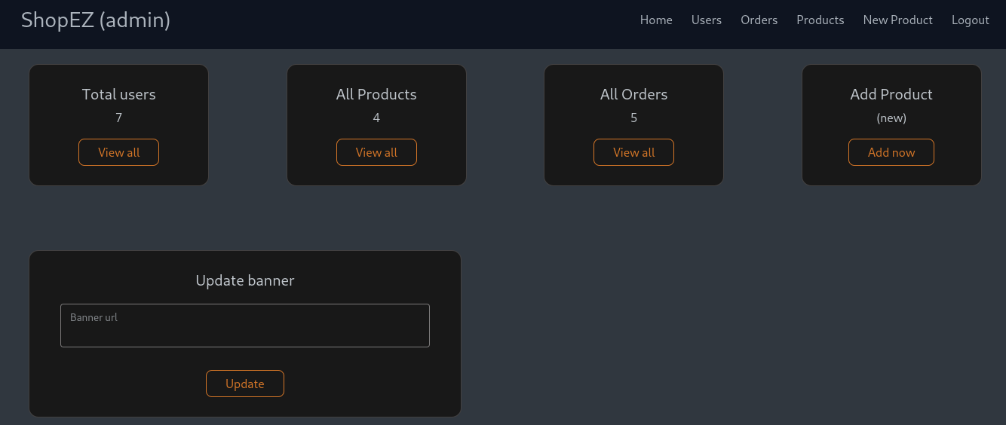
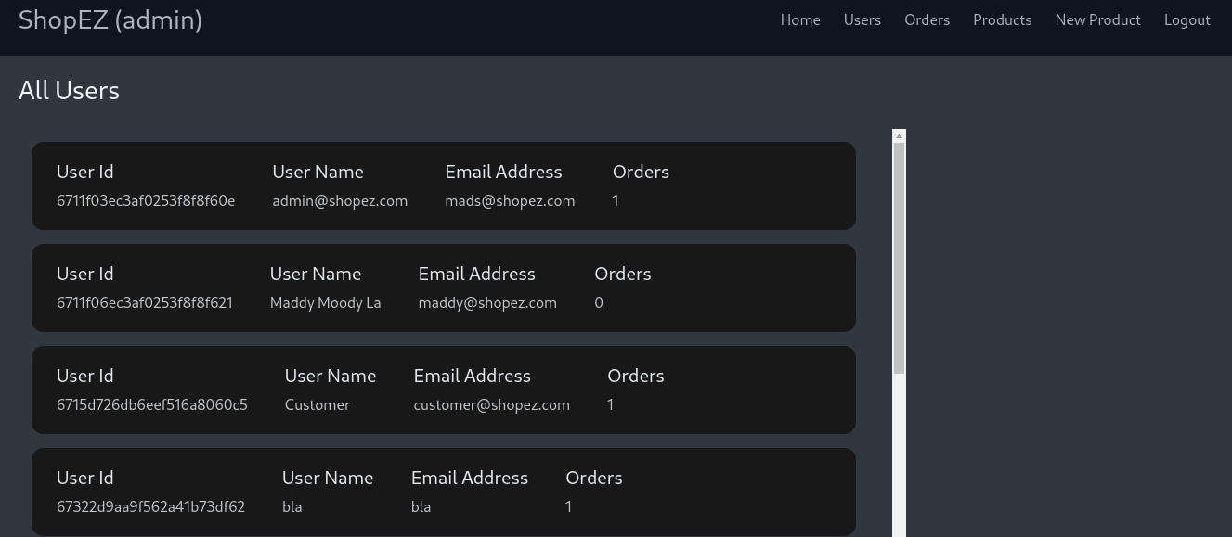
21

Slide 22
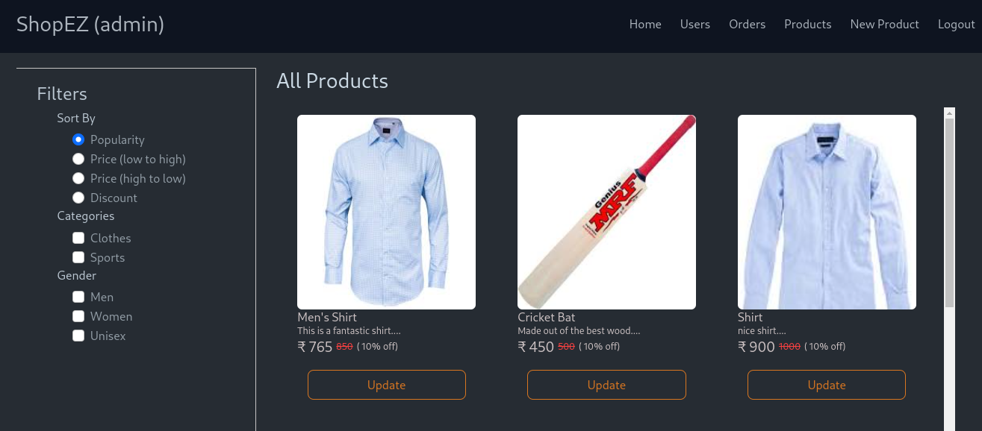
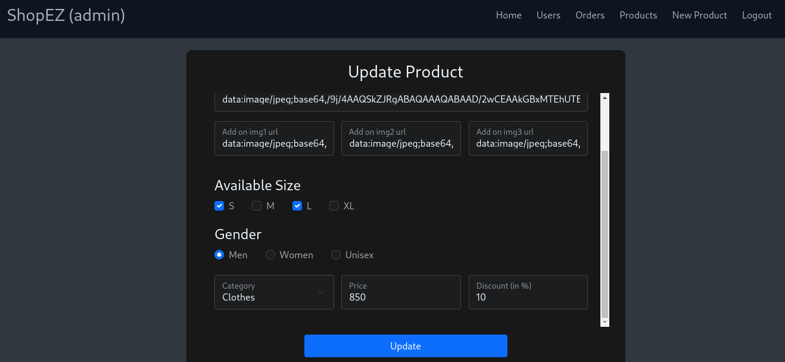
2.Seller Flow (Restaurant)
⦁ Authentication
⦁ Admin Approval
⦁ Product Management
⦁ Order Management
22

Slide 23
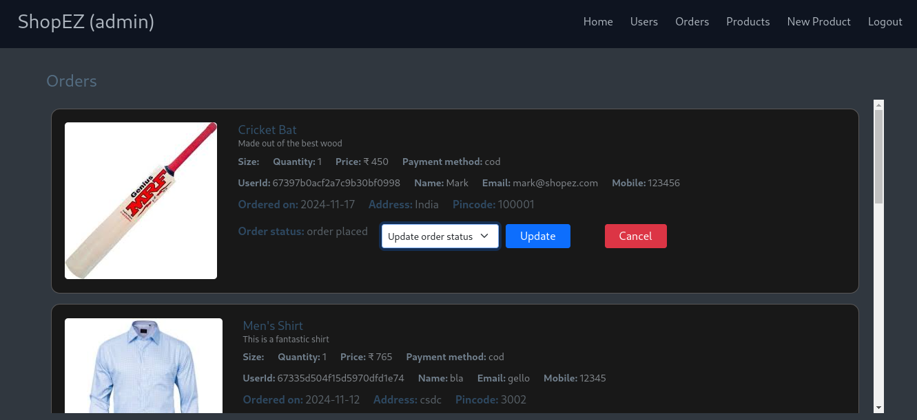
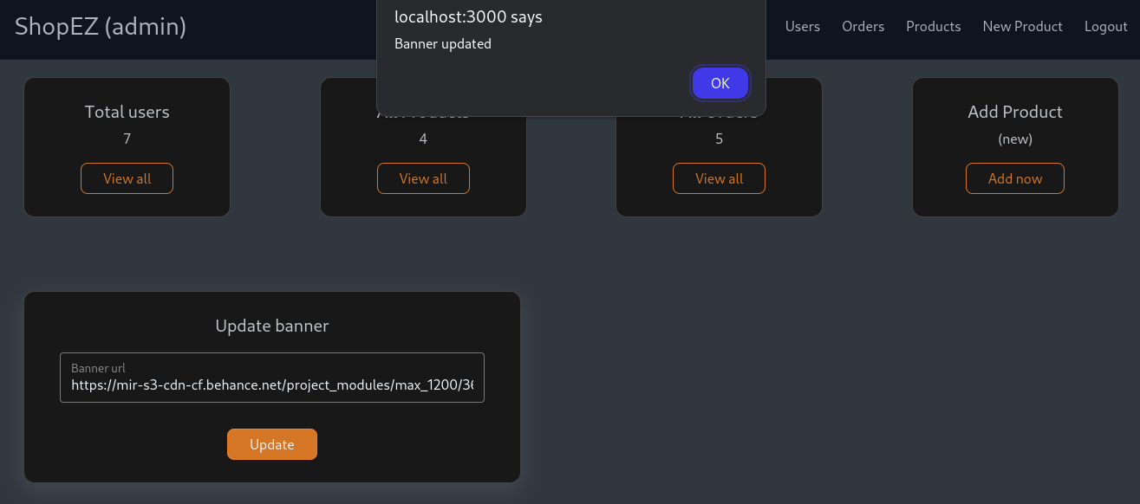
3. Admin Flow
⦁ Login & Dashboard Access
⦁ User Management
⦁ Product and Order Oversight
⦁ Platform Management
23

Slide 24
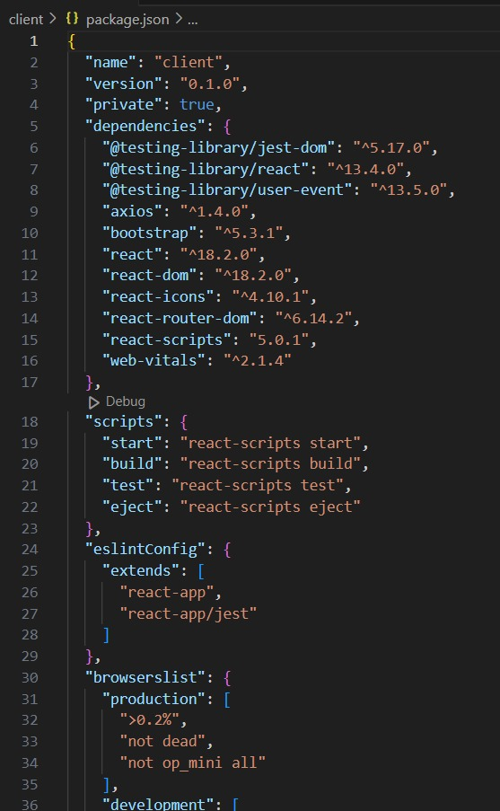
8. PROJECT SETUP & CONFIGURATION
8.1. FRONT-END DEVELOPMENT
⦁ React
⦁ Bootstrap and React-Bootstrap
⦁ Material-UI and Ant Design (Antd)
⦁ Axios
⦁ MDB React UI Kit
⦁ React Router Dom
24

Slide 25
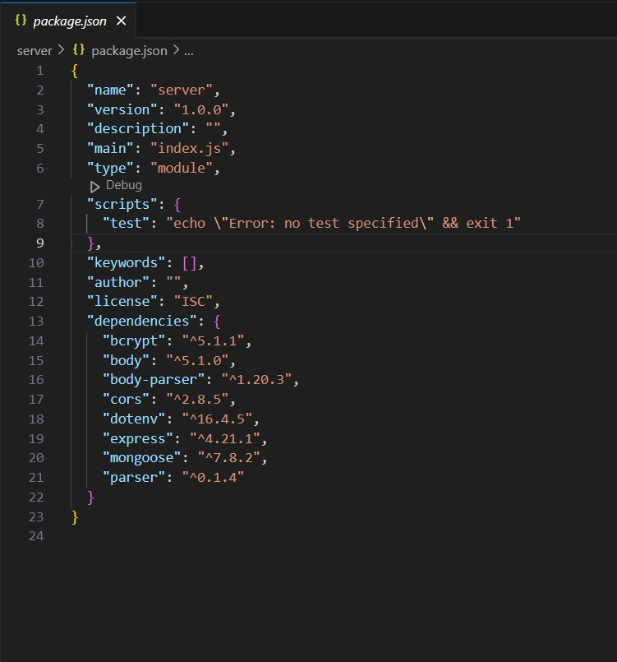
8.2. BACK-END DEVELOPMENT
⦁ Express
⦁ Mongoose:
⦁ JWT (jsonwebtoken)
⦁ CORS
⦁ bcrypt
⦁ body-parser
⦁ dotenv
⦁ Multer
25

Slide 26




Jacket
Sweater
Pants
Skirt
$ 38
$ 21
$ 27
$ 19
9. PROJECT IMPLEMENTATION & EXECUTION
26

Slide 27



Product Excellence
Comfortable to wear
Affordable prices
Using high quality materials
Follow the current fashion trends
Environmentally friendly
27

Slide 28


ORDER NOW
And Enjoy Our Product
+ 123-456-7890
www.reallygreatsite.com
28

Slide 29
CONCLUSION
ShopEZ is a MERN-based e-commerce platform designed for seamless shopping and efficient management. It supports customers with intuitive browsing and secure checkout, sellers with a dashboard for product and order management, and admins with tools for overseeing platform activities. Scalable, secure, and user-focused, ShopEZ sets a strong foundation for modern e-commerce growth and innovation.
Demo Links :
Github Link :
https://github.com/JosanGeorge/NM_Mern_Stack-ShopEZ
https://drive.google.com/file/d/1MYC1tMsTOqXuh5dozuBPEW3iWxyTXhYB/view
Video Link :
29

Slide 30
THANKYOU
30

